Slide 1
High-Performance Python
Bismarck

Slide 2
Python’s Relevance

Slide 3
public class RNGooglePlacePickerModule extends ReactContextBaseJavaModule implements … {
public void onActivityResult(final Activity activity, final int requestCode, final int resultCode, …) {
if (mCallback == null || requestCode != REQUEST_PLACE_PICKER) {
return;
}
response = Arguments.createMap();
if (resultCode == 2) {
response.putString("error", "Google Maps not setup correctly. Did you forget the API …
mCallback.invoke(response);
} else if (resultCode == Activity.RESULT_OK) {
final Place place = PlacePicker.getPlace(data, reactContext);
final CharSequence address = place.getAddress();
final LatLng coordinate = place.getLatLng();
final CharSequence name = place.getName();
final CharSequence id = place.getId();
response.putString("address", address.toString());
response.putDouble("latitude", coordinate.latitude);
response.putDouble("longitude", coordinate.longitude);
response.putString("name", name.toString());
response.putString("google_id", id.toString());
mCallback.invoke(response);
} else {
response.putBoolean("didCancel", true);
mCallback.invoke(response);
return;
}
}
...
In the 2000’s…

Slide 4
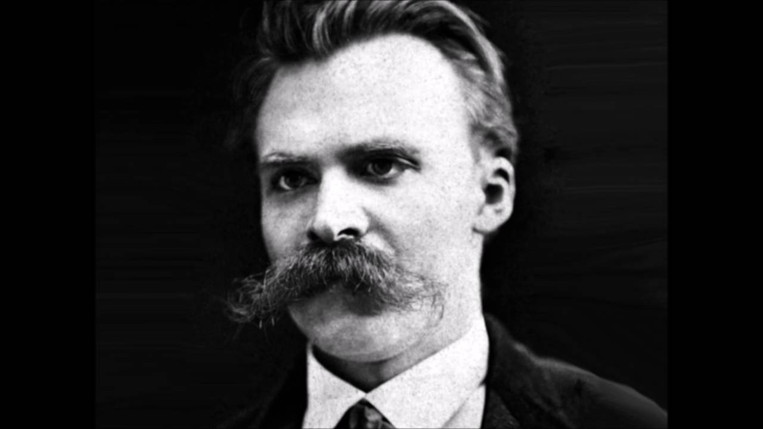
“OOP is Dead”
“OOP is Dead”
- The Internet, 2011

Slide 5

What is Pythonic?

Slide 6
What is Pythonic?
/* ANSI C */
typedef struct Pixel_t{
unsigned char r;
unsigned char g;
unsigned char b;
} Pixel_t;
#pragma alias(image,img_ptr)
register Pixel_t * _Restrict img_ptr = &image;
for (uint32fast_t i = 0; i < descriptor.height; ++i) {
for (uint32fast_t j = 0; j < descriptor.width; ++j) {
img_ptr = image[i*descriptor.width+j] ;
register avg = (img_ptr->r + img_ptr->g + img_ptr->b)/3;
img_ptr->r = avg;
img_ptr->g = avg;
img_ptr->b = avg;
}
}

Slide 7
What is Pythonic?
// C++17
for (auto[&r,&g,&b] : image)
r = g = b = (r + g + b)/3;

Slide 8
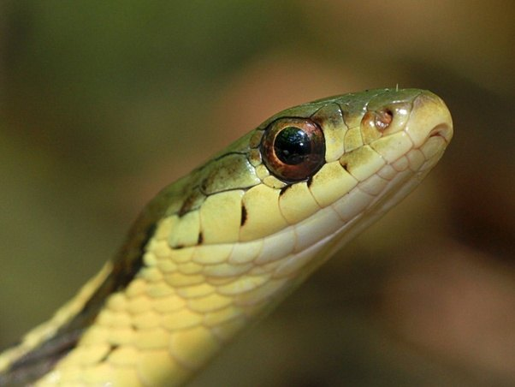

Pythonic VS Magical

Slide 9
Pythonic or Magical?
// C++11 & Boost library thread pool
#include <ctpl.h>
#define N 64
ctpl::thread_pool p(N);
double partial_sum[N] = {0};
vector<future<void>> results(N);
/*Launch threads */
for (int j = 0; j < N; ++j)
/* Partial sum lambda */
results[j] = p.push([&partial_sum, j](int){
for(long long k=j*WORKLOAD; k<(j+1)*WORKLOAD*; ++k)
partial_sum[j]+=(k % 2 ? -1.0 : 1.0) / (2.0 * k + 1.0);
});
double final_result = 0.0;
for (int j = 0; j < N; ++j)
final_result+=results[j].get();

Slide 10
Pythonic or Magical?
// C & OpenMP
#include <omp.h>
omp_set_num_threads(96);
/*Initialize sum */
double sum = 0.0;
/* Approximate pi/4 */
#pragma omp parallel
{
#pragma omp for reduction(+:sum)
for (long long k = 0; k < N; ++k) {
sum += (k % 2 ? -1.0 : 1.0) / (2 * k + 1);
}
}
/* Multiply by four to approximate pi */
result = 4 * sum;

Slide 11
Pythonic
High entropy
Concise
Minimalistic
Readable
“Short and sweet”

Slide 12
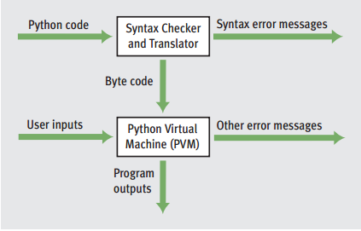
How Python works (generally)

Slide 13
Top Slowdown Factors in Python
Dynamic variables
Flexible datatypes
Interpreter latency
Sequential execution

Slide 14
Solutions
Antidotes
Dynamic variables -> Cython
Flexible datatypes -> Numpy
Interpreter latency -> Numba
Sequential execution -> Multi-threading

Slide 15
General Pro-tips I won’t be covering
Use the collections library
Use generators instead of lists
Use selective imports
Use profile-guided compilation for your C dependencies
Use manual garbage collection when it makes sense

Slide 16
Numba: Magical speedups for Python
JIT compilation
Multi-threading and multi-processing
GPU-assisted execution

Slide 17
Other Technologies
Tensorflow: A more powerful tensor library
Dask: Distributed Python
Pyrex: Basically the same thing as Cython, but harder and less popular

